Slide 1
3 Queries
3.1 Select Queries
Notes:
action queries can create and delete whole tables, as well as make smaller modifications. They are potentially dangerous, & I sha’n’t discuss them or expect you to use them.

Slide 2
“What a database is for”
“Ordinary” queries (interrogate database)
  select (commonest)
  crosstab
Action queries (can modify database)
  won’t cover (potentially dangerous)

Slide 3
Select queries
permanent objects
same query, updated data, new answer
query one or more tables (perhaps via another query)
may use one as a basis of a form or report
QBE (query by example) now
  SQL (Structured Query Language) later
Notes:
the idea of a dynaset (Old Access jargon):
fixed query, changing data, so dynamic (changing) set of records which satisfy query: the dynaset.
eg which students are doing CS205?
SQL is perhaps more powerful / general; text rather than graphics oriented; queries constructed in Access by QBE generate their SQL equivalent, which you can modify

Slide 4
Select queries can:
sort (the order in which records appear)
select (which records appear)
or group (the records) and summarise the groups (later)

Slide 5
Views
Design (QBE)
Datasheet
  updating in datasheet view of some select queries
SQL
  may modify query
Print Preview
  of Datasheet view

Slide 6
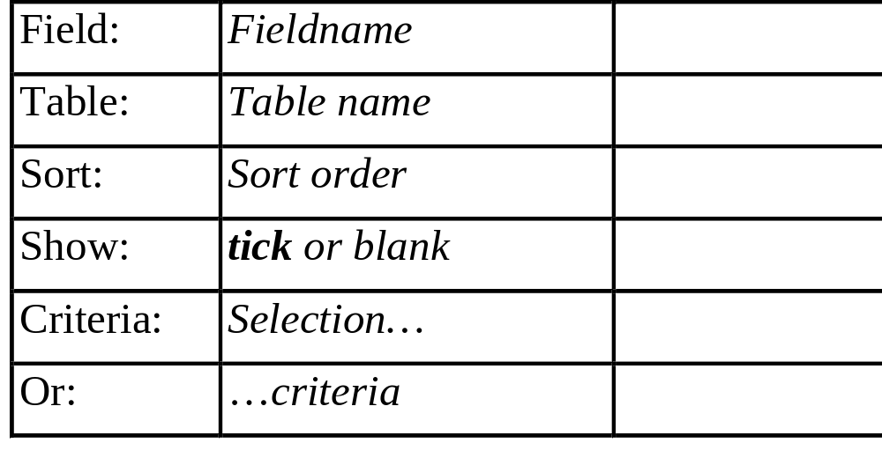
QBE grid
Notes:
can create a query that selects or sorts on unshown fields!!

Slide 7
QBE design
add fields of interest to query grid
then for each field:
choose whether or not to
  sort on
  set criteria on
choose whether or not to show

Slide 8
Sorting
records may be sorted on any field
ascending or descending order
2nd, 3rd,... field to split ties
  2nd, 3rd etc in column order
Notes:
Surnames, split on given names or initials (NOT the same)

Slide 9
Selecting
value in a field …
… equals some given value
  eg Like “Dyfed”
… falls within a range
  eg >10
  eg Between 10 And 20
… is one of a list
  eg In(“Dyfed”, “Gwent”, “Mid Glam”)
Notes:
wildcards are available ? and *
And, Or, Not are available
“...” in Mid Glam to prevent separation at space (Access user-friendly, but can’t do everything)
if criteria on several fields, can have either/or or both apply
can set alternative criteria on same field
possible to set up complex alternatives using several fields
eg Jones from Aber or Williams from Mach
Calculations may be used in criteria eg <Date()+7 for orders due in next 7 days

Slide 10
… wildcards, ranges available
value in a field …
… begins in a specified way
  eg Like “M*”
… has a more specific structure
  eg Like “??3???10”
  eg Like “[a-k]*”
  eg Not Like “[a-k]*”

Slide 11
Combining criteria
firstly, criteria on the same row for different fields are ANDed, then ...
... secondly, different criteria rows are ORed

Slide 12
Calculated fields
queries can contain calculated fields
enter an expression rather than a field name
field names should be enclosed in brackets
  eg [Inches]*2.54
  eg [Population]/[Area]
Access supplies a default name (change it!) used as a column header in datasheet view
  eg Expr1:

Slide 13
3.2 Grouping
can “Group By” one or more fields
“Totals” of various sorts available for the groups
  Sum, Avg, Count, Min, Max, First, Last, StDev, Var
Σ button on toolbar gives “Totals:” row in QBE grid
Notes:
on a student database
grouping by the faculty field & counting the Ucas no. field would produce a count of the number of students in each faculty;
Grouping by the faculty & sex fields & counting the Ucas no field would give the no of students of each sex in each faculty

Slide 14
Totals row of QBE grid
must contain (one of)
  Group By
  a “total”
  Where
  Expression
if there is a Group By, totals are for groups (else for all records)

Slide 15
Can set criteria to …
… select (restrict) the groups used / shown (before calculation)
  set criteria in Group By fields
… select on the basis of the calculated value (after the calculation has been performed) and show only the selected results
  set criteria in the field that specifies the calculation

Slide 16
…
… select (restrict) the records used in the calculation (totalled)
  set criteria in a field with Where in totals row of QBE grid
  if wish to total that field, it will have to appear twice

Slide 17
3.3 Crosstab Queries
form a two-way table
rows & cols each grouped on a field
  subgroups for rows
entries are “totals” of some sort
selection & sorting may also be applied
Notes:
contrast with groups & totals select query (layout)

Slide 18
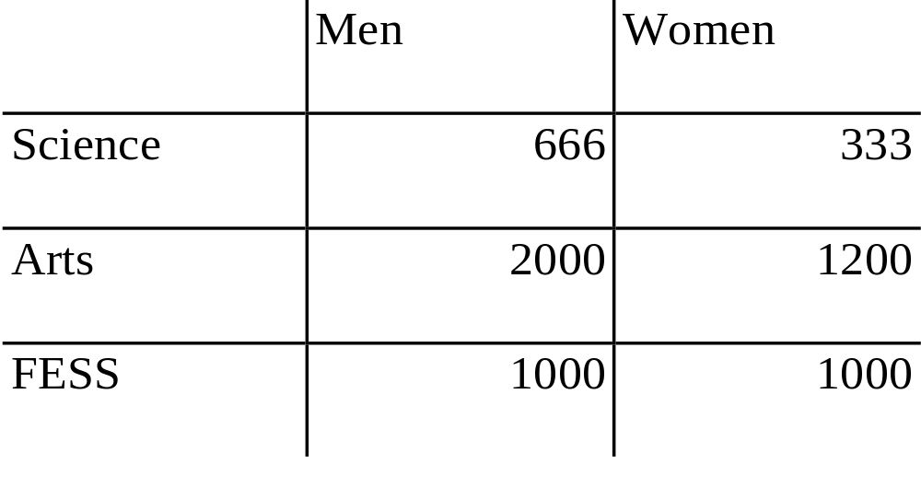
e.g. University of Erewhon

Slide 19
3.4 Parameter Queries
can type in information for criteria at run time
so can use same query eg for monthly report, typing in date(s)
in Criteria: row of QBE grid, type prompt in square brackets [ … ]
  eg [Type beginning date:]
must not be a field name

Slide 20
When query run …
prompt displayed
what you type replaces [prompt] eg
  Criteria: Between [type start date] And [type end date]
  display Response
  type start date 1 Jan 97
  type end date 31 Dec 97
  query runs as
  Between 1 Jan 97 And 31 Dec 97

Slide 21
Unintended Parameter Queries …
… may be produced by mis-spelling a field name in an ordinary select query …
… so if you get a parameter query when you didn’t intend one, check spellings!

Slide 22
3.5 Simple Interrogations
some “quick & dirty” techniques available
better (faster) for unsophisticated interrogation
a Find command for very simple searches (binoculars button), with Replace option
A Sort command for sorting records in a table or form (or A-Z & Z-A buttons)

Slide 23
Filters
quick simple temporary “queries”
can be made permanent as a query
3 toolbar buttons (Filter By Selection, Filter By Form, Apply / Remove
Filter) …
…also Advanced Filter/Sort (via Filter on Records menu)

